Slide 1
Data Formats
Computers and computer-based devices
  Process and store all forms of data in binary format
Human communication
  Includes language, images and sounds
Data formats
  Specifications for converting data into computer-usable form
  Define the different ways human data may be represented, stored and processed by a computer
Copyright 2013 John Wiley & Sons, Inc.
4-<number>

Slide 2
Common Data Representations
Type of Data | Standard(s)
Alphanumeric | Unicode, ASCII, EDCDIC
Image (bitmapped) | GIF (graphical image format) TIFF (tagged image file format) PNG (portable network graphics)
Image (object) | PostScript, JPEG, SWF (Adobe Flash), SVG
Outline graphics and fonts | PostScript, TrueType
Sound | WAV, AVI, MP3, MIDI, WMA
Page description | PDF (Portable Document Format), HTML, XML
Video | Quicktime, MPEG-2, MPEG-4, WMV
Copyright 2013 John Wiley & Sons, Inc.
4-<number>

Slide 3
Representing Characters
ASCII - most widely used coding scheme
EBCDIC: IBM mainframe (legacy)
Unicode: developed for worldwide use
Copyright 2013 John Wiley & Sons, Inc.
4-<number>

Slide 4
ASCII
Developed by ANSI (American National Standards Institute)
Represents
  Latin alphabet, Arabic numerals, standard punctuation characters
  Plus small set of accents and other European special characters
ASCII
  7-bit code: 128 characters
Copyright 2013 John Wiley & Sons, Inc.
4-<number>

Slide 5
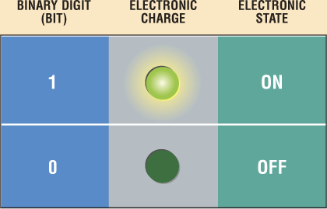
Data Representation
How do computers represent data?
  Most computers are digital
Recognize only two discrete states: on or off
Use a binary system to recognize two states
Use number system with two unique digits: 0 and 1, called bits (short for binary digits)
  Smallest unit of data computer can process

Slide 6
Data Representation
What are three popular coding systems to represent data?
  ASCII—American Standard Code for Information Interchange
  EBCDIC—Extended Binary Coded Decimal Interchange Code
  Unicode—coding scheme capable of representing all
  world’s languages
ASCII Symbol EBCDIC
00110000 0 11110000
00110001 1 11110001
00110010 2 11110010
00110011 3 11110011

Slide 7
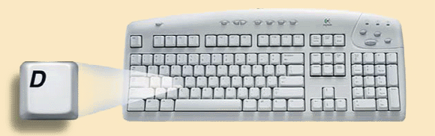
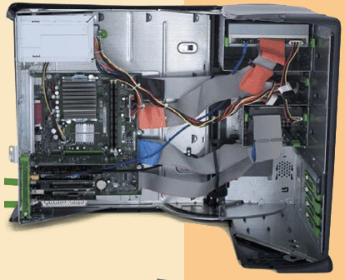

Data Representation
How is a letter converted to binary form and back?
Step 1.
The user presses the capital letter D (shift+D key) on the keyboard.
Step 2.
An electronic signal for the capital letter D is sent to the system unit.
Step 4.
After processing, the binary code for the capital letter D is converted to an image, and displayed on the output device.
Step 3.
The signal for the capital letter D is converted to its ASCII binary code (01000100) and is stored in memory for processing.

Slide 8
Memory
Stores three basic categories of items:
    OS and system software
    Application programs
    Data and information
Byte is basic storage unit in memory
To access data or instructions in memory, computer references the address that contain the bytes of data
Manufacturers state the size of memory and storage devices in terms of number of bytes available

Slide 9
Memory
How is memory measured?
  By number of bytes available for storage
  KB = 1024 bytes
Term Abbreviation Approximate Size
Kilobyte KB or K 1 thousand bytes
Megabyte MB 1 million bytes
Gigabyte GB 1 billion bytes
Terabyte TB 1 trillion bytes

Slide 10
Name | Abbr. | Size
Kilo | K | 2^10 = 1,024
Mega | M | 2^20 = 1,048,576
Giga | G | 2^30 = 1,073,741,824
Tera | T | 2^40 = 1,099,511,627,776
Peta | P | 2^50 = 1,125,899,906,842,624
Exa | E | 2^60 = 1,152,921,504,606,846,976
Zetta | Z | 2^70 = 1,180,591,620,717,411,303,424
Yotta | Y | 2^80 = 1,208,925,819,614,629,174,706,176

Slide 11
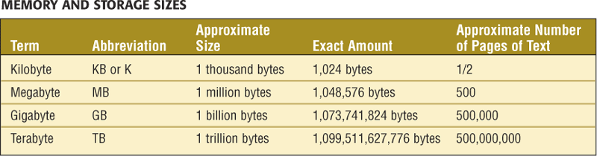

Slide 12
Visual Data
Videos, photographs, biometric images, figures, icons, drawings, charts and graphs
Two approaches:
  Bitmap or raster images of photos and paintings with continuous variation
  Object or vector images composed of graphical objects like lines and curves defined geometrically
Differences include:
  Quality of the image
  Storage space required
  Time to transmit
  Ease of modification
Copyright 2013 John Wiley & Sons, Inc.
4-<number>

Slide 13
Bitmap Images
Used for realistic images with continuous variations in shading, color, shape and texture
Preferred when image contains large amount of detail and processing requirements are fairly simple
Input devices:
  Scanners
  Digital cameras and video capture devices
  Graphical input devices like mice and pens
Managed by photo editing software or paint software
Copyright 2013 John Wiley & Sons, Inc.
4-<number>

Slide 14
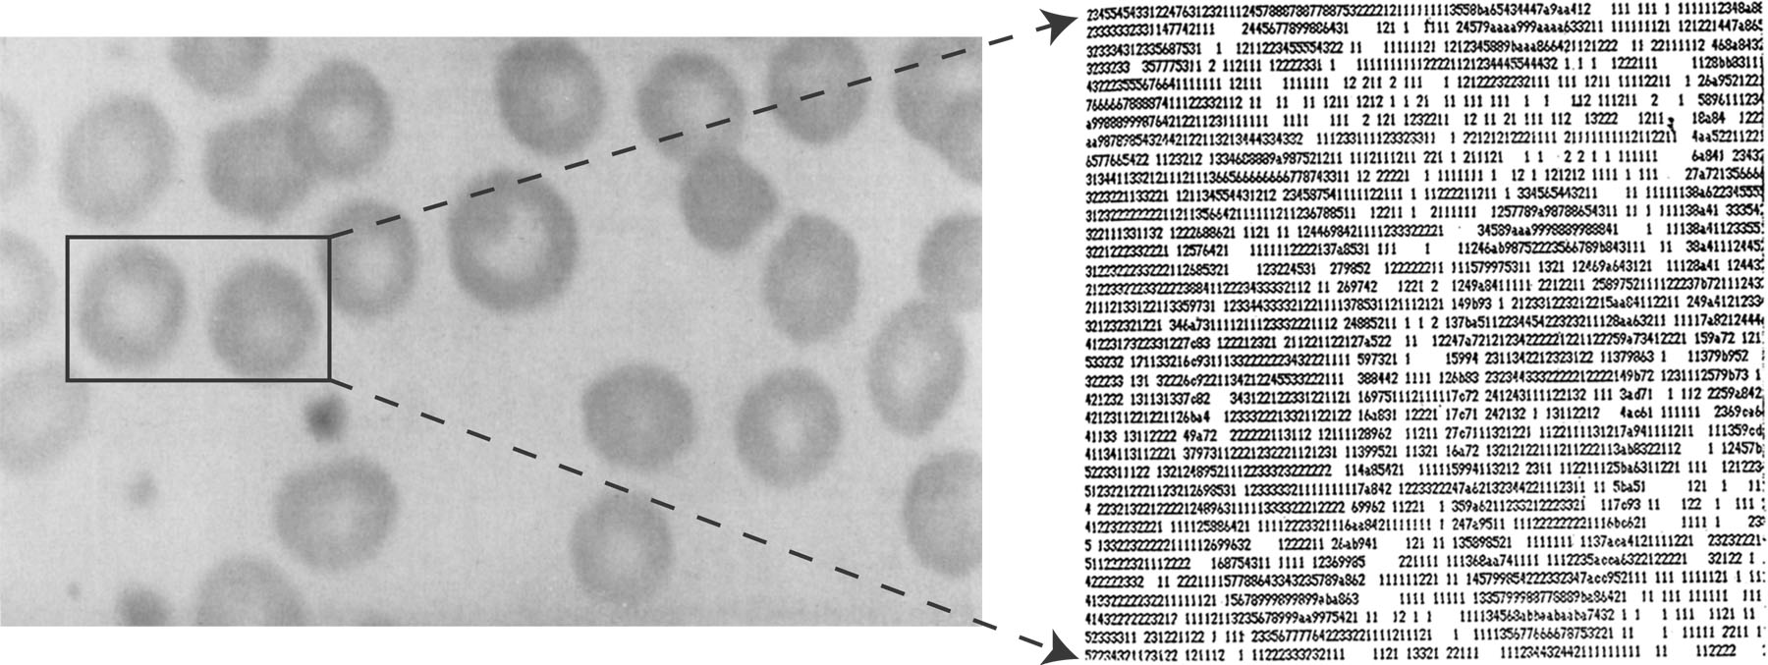
Bitmap Images
Each individual pixel, for pi[x]cture element, in a graphic is stored as a binary number
  Pixel: A small area with an associated coordinate location
  Example: each point below represented by a 4-bit code corresponding to 1 of 16 shades of gray
Copyright 2013 John Wiley & Sons, Inc.
4-<number>

Slide 15
Bitmap Display
Monochrome: black or white
  1 bit per pixel
Gray scale: black, white or 254 shades of gray
  1 byte per pixel
Color graphics: 16 colors, 256 colors, or 24-bit true color (16.7 million colors)
  4, 8, and 24 bits respectively
Copyright 2013 John Wiley & Sons, Inc.
4-<number>

Slide 16
GIF (Graphics Interchange Format)
First developed by CompuServe in 1987
GIF89a enabled animated images
  Allows images to be displayed sequentially at fixed time sequences
Color limitation: 256
Image compressed by LZW (Lempel-Zif-Welch) algorithm
Preferred for line drawings, clip art and pictures with large blocks of solid color
Lossless compression
Copyright 2013 John Wiley & Sons, Inc.
4-<number>

Slide 17
PNG (Portable Network Graphics)
Losslesly-compressed alternative to GIF
Can store up to 48 bits of color per pixel
Can also store transparency percentage value and color correction factor for monitor or printer
More efficient compression algorithm than GIF
Copyright 2013 John Wiley & Sons, Inc.
4-<number>

Slide 18
JPEG (Joint Photographers Expert Group)
Allows more than 16 million colors
Suitable for highly detailed photographs and paintings
Employs lossy compression algorithm that
  Discards data to decreases file size and transmission speed
  May reduce image resolution, tends to distort sharp lines
Copyright 2013 John Wiley & Sons, Inc.
4-<number>

Slide 19
Object Images
Based on mathematical formulas
  Easy to move, scale, and rotate without losing shape and identity as bitmap images may
Require less storage space than bitmap images
Cannot represent photos or paintings
Cannot be displayed or printed directly
  Must be converted to bitmap since output devices except plotters are bitmap
Copyright 2013 John Wiley & Sons, Inc.
4-<number>

Slide 20
PostScript
Page description language: list of procedures and statements that describe each of the objects to be printed on a page
  Stored in ASCII or Unicode text file
  Interpreter program in computer or output device reads PostScript to generate image
Scalable font support
  Font outline objects specified like other objects
Copyright 2013 John Wiley & Sons, Inc.
4-<number>

Slide 21
Bitmap vs. Object Images
Bitmap (Raster) | Object (Vector)
Pixel map | Geometrically defined shapes
Photographic quality | Complex drawings
Paint software | Drawing software
Larger storage requirements | Higher computational requirements
Enlarging images produces jagged edges | Objects scale smoothly
Resolution of output limited by resolution of image | Resolution of output limited by output device
Copyright 2013 John Wiley & Sons, Inc.
4-<number>

Slide 22
Video Images
Require massive amount of data
  Video camera producing full screen 1024 x 768 pixel true color image at 30 frames/sec 70.8 MB of data/sec
  1-minute film clip 4.25 GB storage
Options for reducing file size: decrease size of image, limit number of colors, or reduce frame rate
Video format determined by a codec, encoder/decoder
Copyright 2013 John Wiley & Sons, Inc.
4-<number>

Slide 23
Video Images
Best known codec standards: MPEG-2, MPEG-4, and H.264
  Data may be compressed to 10-60 MB or less of data per minute
Container serves as a superstructure to encode, decode, hold and stream the video
  Examples: Quicktime from Apple, WebM from Google, and Flash Video from Adobe
Streaming video: video displayed in real time as it is downloaded from the Web server
Copyright 2013 John Wiley & Sons, Inc.
4-<number>

Slide 24
Audio Data
Transmission and processing requirements less demanding than those for video
Analog Waveform: digital representation of sound
Analog sound converted to digital values by A-to-D converter
MIDI (Musical Instrument Digital Interface): instructions to recreate or synthesize sounds
Copyright 2013 John Wiley & Sons, Inc.
4-<number>

Slide 25
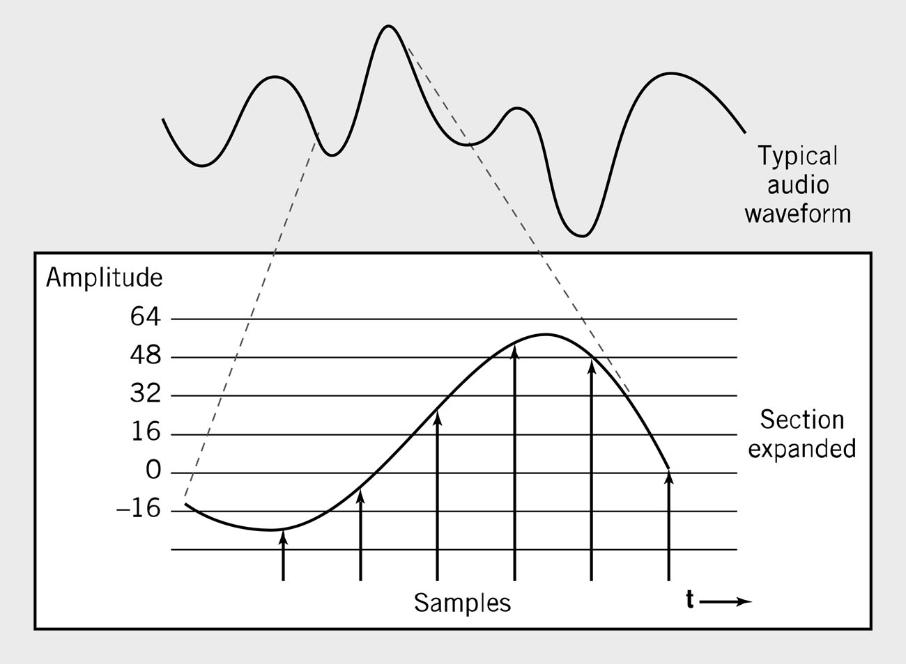
Waveform Audio
Sampling rate normally 50KHz
Copyright 2013 John Wiley & Sons, Inc.
4-<number>

Slide 26
Sampling Rate
Number of times per second that sound is measured during the recording process.
  1000 samples per second = 1 KHz (kilohertz)
  Example: Audio CD sampling rate = 44.1KHz
Height of each sample saved as:
  8-bit number for radio-quality recordings
  16-bit number for high-fidelity recordings
  2 x 16-bits for stereo
Copyright 2013 John Wiley & Sons, Inc.
4-<number>

Slide 27
Audio Formats
MP3 – predominant digital audio data format
  Derivative of MPEG-2 (ISO Moving Picture Experts Group)
  Uses psychoacoustic lossy compression techniques to reduce storage requirements
WAV
  Developed by Microsoft as part of its multimedia specification
  General-purpose format for storing and reproducing small snippets of sound
  Non-compressed 8- or 16-bit sound samples
Copyright 2013 John Wiley & Sons, Inc.
4-<number>

Slide 28
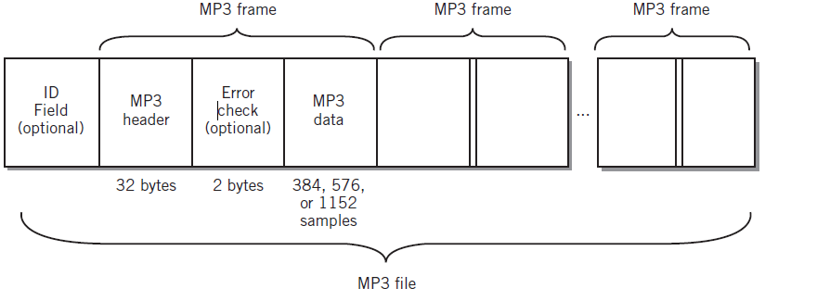
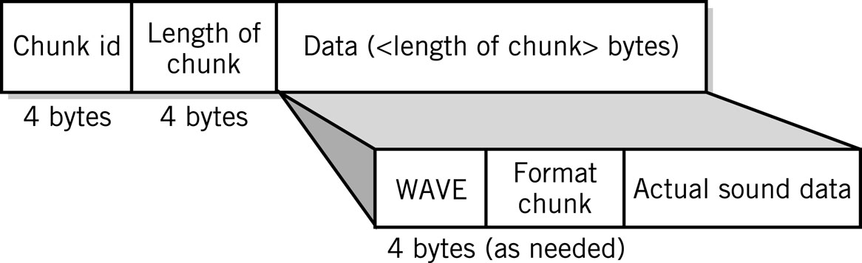
Audio Data Formats
WAV file
Copyright 2013 John Wiley & Sons, Inc.
4-<number>

Slide 29
Data Compression
Compression: recoding data so that it requires fewer bytes of storage space.
Compression ratio: the amount file size is reduced
Lossless: inverse algorithm restores data to exact original form
  Examples: GIF, PCX, TIFF, ZIP
Lossy: trades off data degradation for file size and download speed
  Much higher compression ratios, often 10 to 1
  Example: JPEG, MP3
  Common in multimedia
H.264: uses both forms for ratios of 1000:1
Copyright 2013 John Wiley & Sons, Inc.
4-<number>

Slide 30
Page Description Languages
Describe layout of objects on a displayed or printed page
Objects may include text, object images, bitmap images, multimedia objects, and other data formats
Examples
  HTML, XHTML, XML
  PDF
  Postscript
Copyright 2013 John Wiley & Sons, Inc.
4-<number>

Slide 31
Internal Computer Data Format
All data stored as binary numbers
Interpreted based on
  Operations computer can perform
  Data types supported by programming language used to create application
Copyright 2013 John Wiley & Sons, Inc.
4-<number>

Slide 32
5 Simple Data Types
Boolean: 2-valued variables or constants with values of true or false
Char: Variable or constant that holds alphanumeric character
Enumerated
  User-defined data types with possible values listed in definition
    Type DayOfWeek = Mon, Tues, Wed, Thurs, Fri, Sat, Sun
Integer: positive or negative whole numbers
Real
  Numbers with a decimal point
  Numbers whose magnitude, large or small, exceeds computer’s capability to store as an integer
Copyright 2013 John Wiley & Sons, Inc.
4-<number>

Slide 33
Copyright 2013 John Wiley & Sons
All rights reserved. Reproduction or translation of this work beyond that permitted in section 117 of the 1976 United States Copyright Act without express permission of the copyright owner is unlawful. Request for further information should be addressed to the Permissions Department, John Wiley & Sons, Inc. The purchaser may make back-up copies for his/her own use only and not for distribution or resale. The Publisher assumes no responsibility for errors, omissions, or damages caused by the use of these programs or from the use of the information contained herein.”
Copyright 2013 John Wiley & Sons, Inc.
4-<number>

